Slide 1
Dependence
Junior Cycle Wellbeing
supported by
Notes:
This lesson is about understanding what the warning signs are for dependence on different substances or behaviours. The notes at the bottom here are a sample narration of the lesson. They are only intended as a guide, as with all lessons bringing your own personal style will to the lesson is always important.
Words in italics are teacher talk and words in normal text are notes.

Slide 2
what do we mean by “dependence”?
Notes:
So one of the first things we need to figure out is what do we mean by "dependence"?
Would anyone like to suggest a sign of becoming dependent on something?
Class discussion to lay out student's prior knowledge.

Slide 3
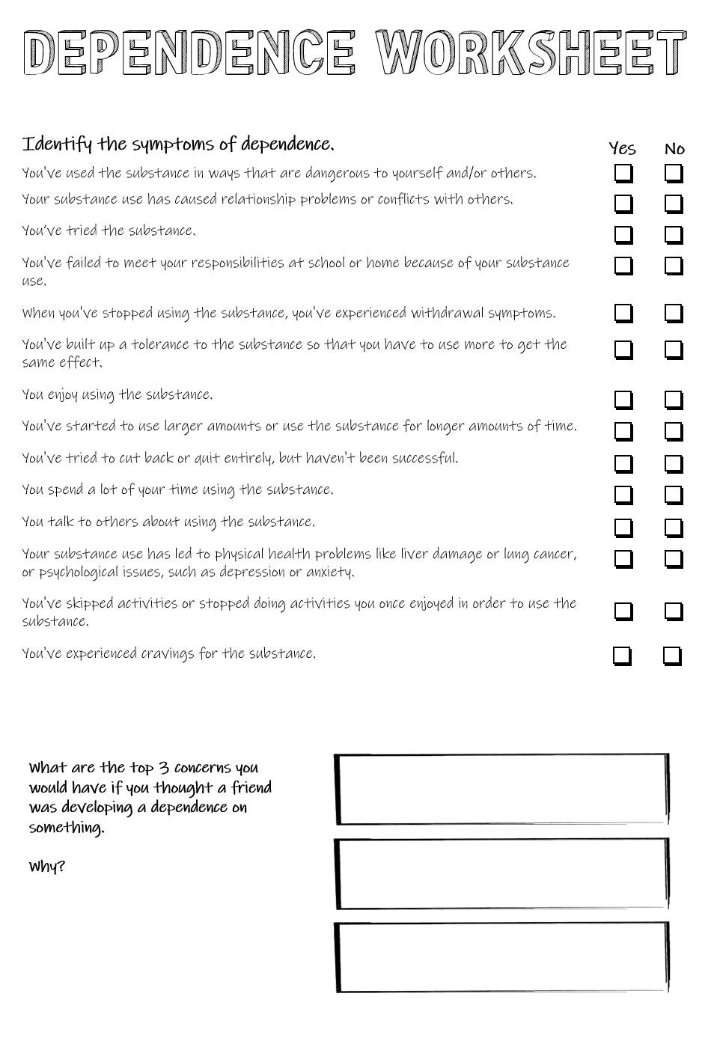
Notes:
When doctors consider whether people have developed a dependence on something, they look at a list of symptoms. Our first activity is to identify which of these symptoms are the official signs of dependence. Tick yes or no.
Activity can be done individually or in groups.

Slide 4
Social or interpersonal problems because of use
Used in ways that are dangerous
Physical or psychological problems because of use
Using increasing amounts
Symptoms of dependence
Tried and failed to reduce use
Failed to meet your responsibilities
Experience withdrawal symptoms
Spending a lot of time using
Experience cravings
Given up something because of use
You’ve built up a tolerance
Notes:
And here are our answers, these are the official symptoms of dependence. Experiencing 4 or 5 of these in a 12 month period would indicate a moderate level of dependence, 6 or more a severe level.
Note: technically these are the DSM criteria for a "substance use disorder" which is the term being used to replace dependence. However, in pilots of this lesson students found the language complex and we have substituted the older term dependence for clarity.

Slide 5
Discussion
What kind of substances or behaviours can be abused?
Notes:
So now that we know a bit more about what we mean by dependence, what kind of substances or behaviours can you think of that can be abused? Think-pair-share.

Slide 6
Walking debate
Second years need to know about problems with dependence.
Notes:
Now it's time to get up on our feet. We're going to have a walking debate to see if this is something that is relevant or not. Our topic today: "Second years need to know about problems with dependence".
We're going to clear a path across the room, the wall on your right is Yes – I completely agree, the wall on your left is No – I completely disagree. The middle of the room is 50-50, and everywhere else is somewhere along a scale of completely yes to completely no. Let's go!
Run the debate to see how relevant students think this is. It's a good chance to see what their issues are and for them to see what their classmates think.

Slide 7
How can use of drugs affect our mental health?
Notes:
It's possible that someone brought up health or mental health issues in the previous debate, if so you have a great lead into this section.
If not: Now one important thing that we need to be aware of with any health issue, is how does it affect our mental health? Let's hear from one of the Irish experts in this field, Dr Bobby Smyth about how drugs can affect our mental health.

Slide 8
Notes:
Video discussing the effect of drugs on our mental health with Dr Bobby Smyth from HSE and Dr Aisling O'Neill from RCSI.

Slide 9
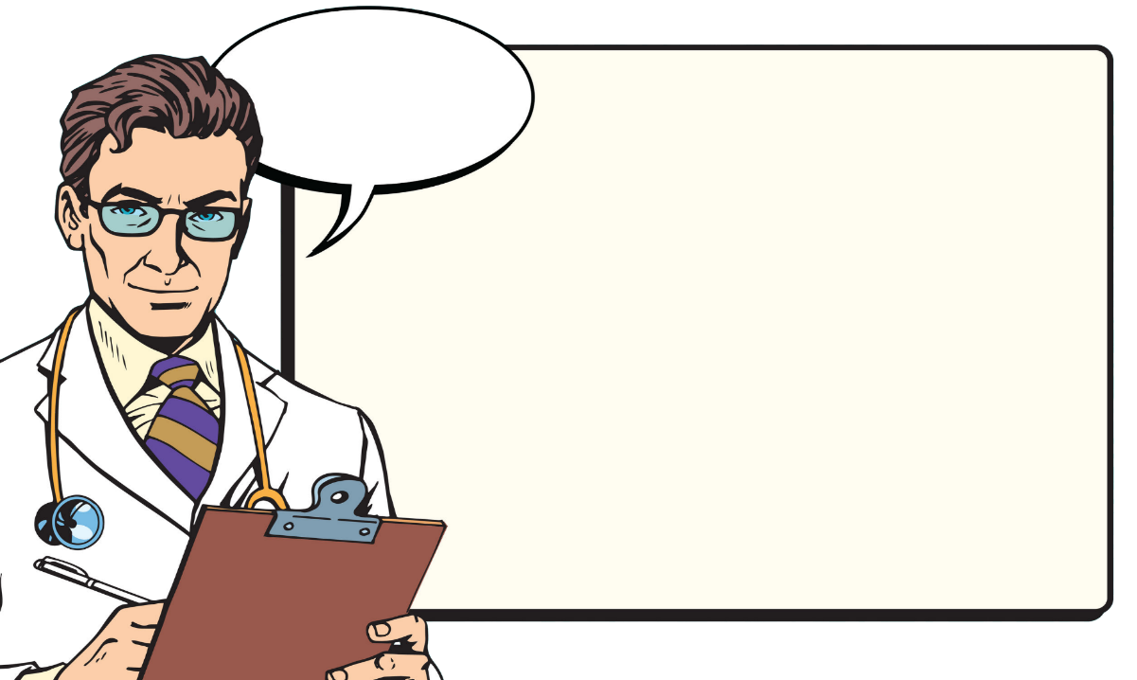
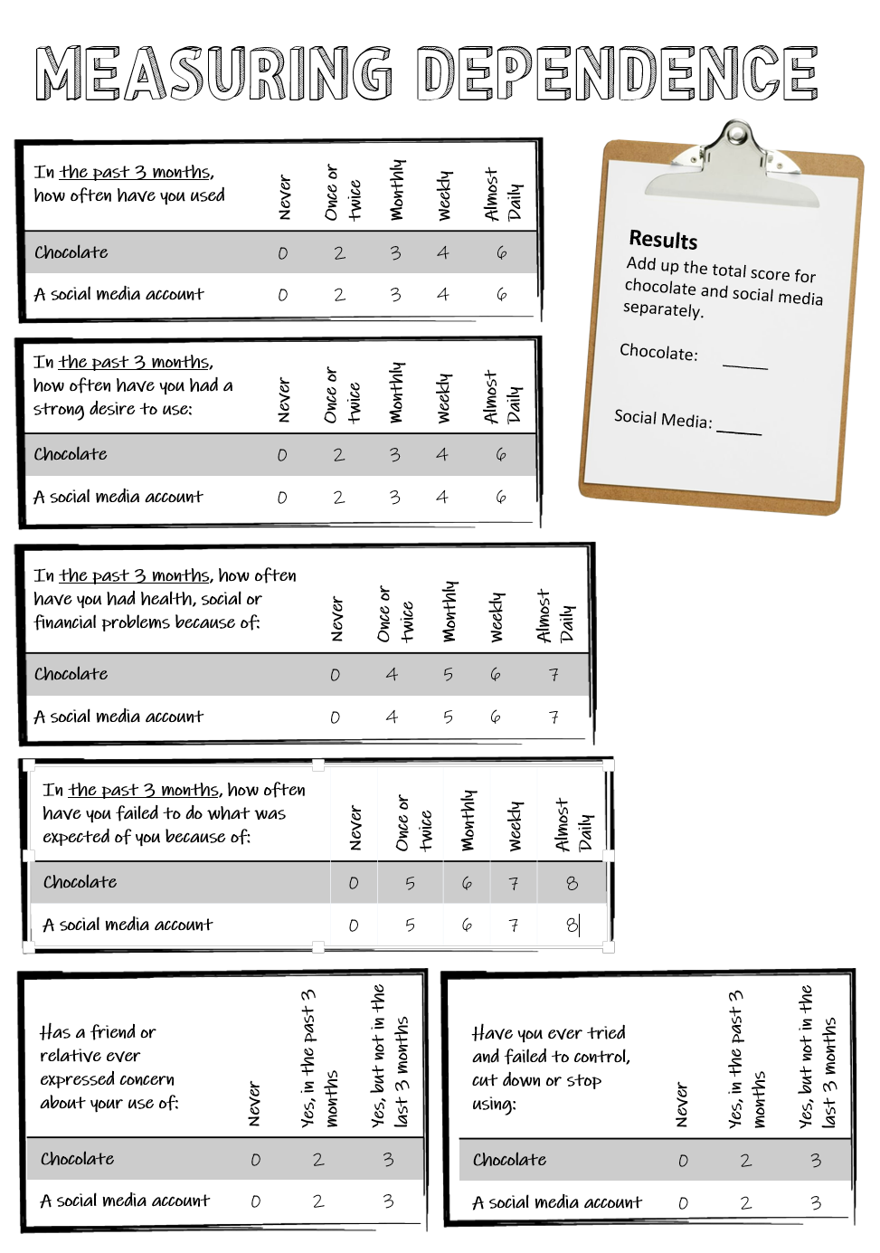
Let’s run an experiment
Fill in the survey
for your use of:
Chocolate
Social Media
Notes:
Now that we have a better understanding of dependence and the challenges it can create, let's do a little survey on our won dependence. We'll have a bit of fun by looking at our dependence on chocolate and social media use. Turn your worksheet over and fill in this test on dependence. When you're done, add up your scores for each one and write them down in the results section on the right.
Note: This is a lightly modified version of the ASSIST questionaire v3 which is used to diagnose substance use disorders. The goal here is for students to see the key things that indicate there is a problem.

Slide 10
What results did we get?
Results
Chocolate
Social Media
Notes:
If you can project directly onto the whiteboard in the classroom, then it works well to write the results up on to this slide. Depending on your group, you can either have students call out their overall result or walk around and record them yourself before writing them up. If you have a mixed class, then it can be fun to write up the boys and girls in different coloured marker. If you're a science teacher, you may feel the urge to ask for a prediction or hypothesis about the results before collecting them.
Great, now that we're done let’s see what the results are. I'm going to ask everyone for their result and write them up.

Slide 11
Do you notice any patterns?
Results
Chocolate
Social Media
Notes:
Now, let's be scientists for a minute: do you notice patterns in the data?
Things that might emerge:
Students with a high score on chocolate have a correspondingly high score for social media.
Social media dependency is higher (what does this say about the design of social media platforms?)
There are outliers

Slide 12
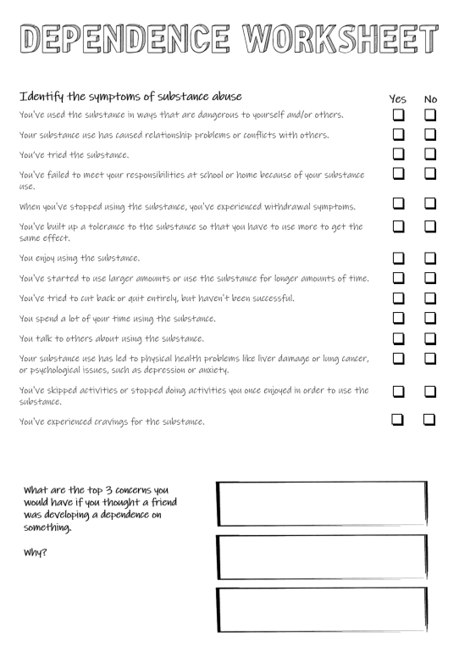
Groups
What are the top three concerns for dependence in this test?
Do you agree?
Notes:
This test had six questions, but out of those 6 what do you think are the top three concerns in terms of developing a dependence on something? Think about this and write them into your worksheet.
This makes a good group activity. The main issue here is that the scoring system is weighted towards 2 particular concerns so there are two correct answers: health/social/financial problems and failing to do what was expected of you. There is no clear answer for the 3rd top concern and the idea here is to generate some debate amongst students. If they're discussing the concerns, they're learning about them. Remember, the key takeaway for this lesson is for students to know the warning signs of dependence.

Slide 13
Reflection
What are the warning signs of dependence to look out for?
Notes:
Ok, let's bring it all back together before the end of our lesson. We've seen that we can become dependent on variety of substances and behaviours. If this happens, we lose control of our relationship with that substance or behaviour and it begins to have a negative impact on our life and on the lives of those around us. The main thing that I want you to know leaving here is what are the major warning signs of dependence that we need to be able to look out for. Can anyone suggest a warning sign?
Class discussion and conclude lesson.

